Slide 1




Data Science Project on SpaceX Launches
Analyzing Success Factors and Predictions
Natalia Tkachenko
GitHub
Это изображение, автор: Неизвестный автор, лицензия: CC BY

Slide 2
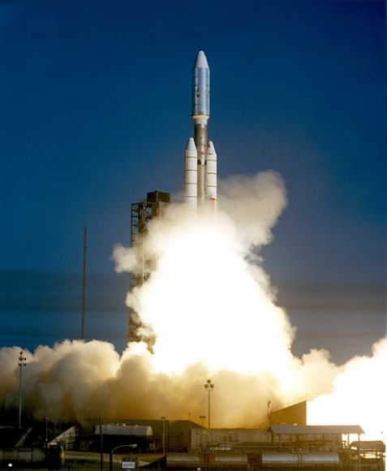
EXECUTIVE SUMMARY
Why This Project Matters:
SpaceX has revolutionised space travel, slashing launch costs with its reusable Falkon 9 rokets. While competitors charge up to $165 million per launch, SpaceX delivers missions at just $62 million, thanks to their groundbreaking ability to recover and reuse the first-stage booster.
But here’s the catch: not every landing is successful. This project dives deep into the data to uncover the secrets behind successful landings.
This project dives deep into the data to uncover the secrets behind successful landings. By predicting when and why a Falcon 9’s first stage will stick the landing, we unlock the potential to optimize costs, enhance efficiency, and gain a competitive edge in the space industry.
Это изображение, автор: Неизвестный автор, лицензия: CC BY

Slide 3

Introduction
The Role of Data Science in SpaceX’s Success The success of SpaceX’s Falcon 9 rockets isn’t just about engineering; it’s also about the power of data. With every launch, massive amounts of data are generated, from payload characteristics to launch conditions and landing outcomes. This project applies data science methodologies to analyze these factors, identify patterns, and predict whether the Falcon 9 first stage will land successfully.
By leveraging machine learning, data visualization, and statistical analysis, we aim to uncover actionable insights that can optimize operational efficiency and reduce costs further. This project highlights how data-driven decision-making plays a crucial role in modern space exploration, enabling SpaceX to stay ahead in the competitive commercial space industry.
Key Questions Explored
How do payload mass, orbit type, and launch site affect the likelihood of a successful landing?
Can trends in historical data reveal improvements in landing success rates over time?
Which machine learning algorithm is best suited for predicting first-stage landing outcomes?

Slide 4

Data Collection and Processing Methodology
Data Collection Methods
SpaceX REST API
Accessed detailed launch data using endpoints like /rockets, /launchpads, /payloads, and /cores.
Extracted booster details, payload information, orbit data, and landing outcomes for analysis.
Transformed raw JSON responses into structured Pandas DataFrames.
Web Scraping
Retrieved historical Falcon 9 and Falcon Heavy launch data from Wikipedia.
Parsed HTML tables with BeautifulSoup to collect details like launch site, payload mass, orbit type, and customer information.
Ensured consistency with preprocessed data by using a static version of the webpage.

Slide 5
Data Collection and Processing Methodology
2. Data Wrangling and Formatting:
Filtering and Cleaning:
Removed irrelevant rows and entries with multiple payloads or cores to maintain a uniform structure.
Handled missing values by replacing them with statistical measures like the mean (e.g., for Payload Mass).
Feature Engineering:
Created additional columns like Class for binary classification (1 for successful landings, 0 for failures).
Extracted and reformatted information (e.g., datetime fields, numeric conversions).
Normalization:
Standardized categorical features using One-Hot Encoding.
Reformatted data into 90 rows with 17 consistent features.

Slide 6
Data Collection and Processing Methodology
3. Tools and Techniques:
Libraries Used:
Pandas for data manipulation.
NumPy for mathematical operations.
BeautifulSoup and Requests for web scraping and API integration.
API Integration:
Automated data extraction with Python functions to retrieve rocket, payload, and core details via SpaceX’s API.
Output:
Cleaned, consolidated dataset ready for exploratory data analysis and predictive modeling.

Slide 7
Methodology: Exploratory Data Analysis (EDA) and Interactive Data Visualization
1. Exploratory Data Analysis (EDA)
Purpose: EDA helps uncover patterns, relationships, and insights from raw data, preparing it for further modeling and prediction.
Tools Used:
Pandas: For data manipulation and aggregation.
NumPy: To perform mathematical computations.
SQL: For complex queries and structured data analysis.

Slide 8
Methodology: Exploratory Data Analysis (EDA) and Interactive Data Visualization
Descriptive Statistics:
Analyzed key metrics such as payload mass, success rates, and flight numbers.
Correlation Analysis:
Explored relationships between variables like payload mass and launch success.
SQL Queries:
Examples:
Count of unique launch sites.
Payload mass carried by NASA (CRS) missions.
Success rate by orbit type.

Slide 9

Methodology: Exploratory Data Analysis (EDA) and Interactive Data Visualization
2. Interactive Data Visualization
Purpose: Interactive visuals make it easier to identify trends, outliers, and patterns, facilitating decision-making.
Tools Used:
Matplotlib and Seaborn: For scatter plots, bar charts, and time-series visualizations.
Folium: For geographic data visualization and interactive mapping.
Plotly Dash: For creating interactive dashboards.

Slide 10
Visualization Examples:
Scatter Plots:
Payload Mass vs. Success Rate.
Flight Number vs. Launch Site.
Bar Charts:
Success rates by orbit type.
Payload mass distributions.
Time Series Analysis:
Success rate trends over the years.
4.Interactive Dashboards were created using Plotly Dash, allowing users to:
Filter data by payload range.
View success rateOutcome: Through EDA and visualizations, patterns such as payload mass affecting success rates and launch site performance variations were uncovered. These insights informed the selection of features for predictive modeling and enabled intuitive storytelling through interactive visuals.s by launch site.
Analyze success probabilities visually.
Outcome: Through EDA and visualizations, patterns such as payload mass affecting success rates and launch site performance variations were uncovered. These insights informed the selection of features for predictive modeling and enabled intuitive storytelling through interactive visuals.

Slide 11
Predictive Analysis Methodology
Machine Learning for Falcon 9 First-Stage Landing Prediction
Predicting whether the Falcon 9 first stage will land successfully is critical for optimizing launch costs and improving competitive advantage. This methodology leverages machine learning models to achieve high predictive accuracy through a systematic process of data preparation, model training, and hyperparameter tuning.
Key Steps
Data Preprocessing:
Converted the Class column into a NumPy array for labels.
Standardized the feature dataset using StandardScaler to normalize values for better model performance.
Split the dataset into training (80%) and testing (20%) subsets using train_test_split.
Model Training and Hyperparameter Tuning:
Utilized GridSearchCV for hyperparameter optimization across four machine learning algorithms:
Logistic Regression: Tuned parameters such as C, penalty, and solver.
Support Vector Machine (SVM): Tuned kernel types, regularization C, and gamma.
Decision Tree: Optimized depth, split criteria, and minimum sample splits.
K-Nearest Neighbors (KNN): Tuned the number of neighbors, algorithms, and distance metrics.
Evaluation:
Measured performance using metrics like accuracy, F1-score, and confusion matrix analysis.
Compared results across all models to determine the best-performing method.

Slide 12
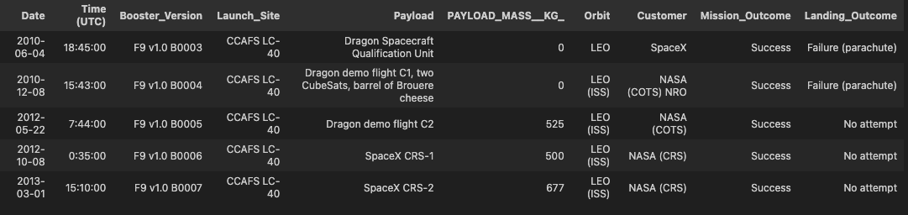
REsults
EDA with SQL results
This section presents the tasks of analyzing SpaceX data using Python and SQL. The main goal was to explore the dataset, load it into a Db2 database table, and execute SQL queries to answer specific questions.
Understanding the SpaceX Dataset: Records of the initial launches are presented, including details such as date, time, launch sites, and landing outcomes.

Slide 13

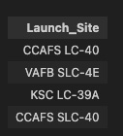
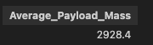
REsults
EDA with SQL results
Average and Total Payload Mass
Unique Launch Sites
The average payload mass is calculated to be 2928.4 kg, and the total payload mass across all missions is 48,213 kg
All launch sites are shown, highlighting the distribution of missions across different locations.

Slide 14
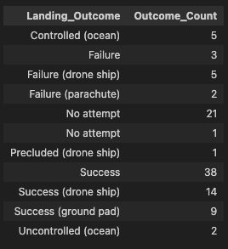
REsults
EDA with SQL results
Landing Outcomes
A detailed analysis of landing outcomes, including successful, failed, and missed attempts, with distribution by count.
This approach not only provides an in-depth exploration of SpaceX mission data but also answers specific questions using SQL queries, ensuring a precise and structured analysis.

Slide 15



REsults
EDA with visualization
This section provides insights into SpaceX's rocket launch data, focusing on critical factors influencing mission outcomes.
The visualizations explore various relationships, including launch sites, payload mass, orbit types, and flight numbers, relative to success rates.
Observations reveal how different features, such as orbit type or payload mass, correlate with successful landings, emphasizing patterns and trends over the years.
Key findings
The progression of success rates by year, showcasing SpaceX's improvements.
The impact of payload mass and flight numbers on launch success across different orbits and launch sites.
Comparative success rates by orbit types, identifying high-performing orbits like LEO and SSO.

Slide 16
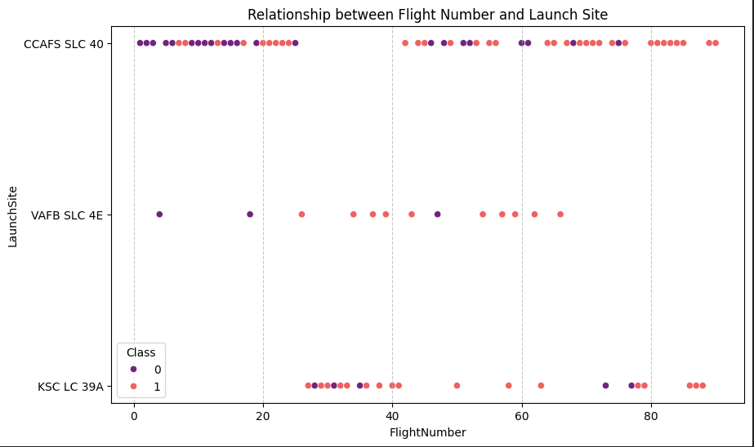
REsults
EDA with visualization
This scatterplot illustrates the relationship between flight numbers and launch sites (CCAFS SLC-40, VAFB SLC-4E, and KSC LC-39A), with the class variable indicating success (1) or failure (0).
CCAFS SLC-40: This site has the most launches, showing both successes and failures. Success rates seem to improve with higher flight numbers.
VAFB SLC-4E: This site has fewer launches, with mixed outcomes, suggesting it is less utilized than
CCAFS SLC-40.KSC LC-39A: This site has consistently successful outcomes for most launches, especially at higher flight numbers.
Overall, the trend suggests that higher flight numbers correlate with more successes across all launch sites, demonstrating improved operational reliability over time.

Slide 17
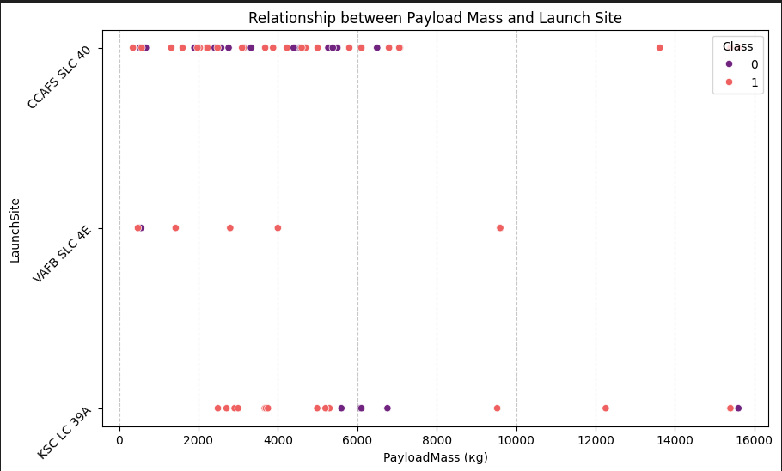
REsults
EDA with visualization
This scatterplot illustrates the relationship between payload mass (in kilograms) and launch sites (CCAFS SLC-40, VAFB SLC-4E, and KSC LC-39A), with the class variable indicating success (1) or failure (0) of the mission
CCAFS SLC-40: The most launches occur at this site, spanning a wide range of payload masses. Success (1) is more prevalent across payloads up to approximately 10,000 kg.
VAFB SLC-4E: This site handles fewer launches and payloads are typically smaller (below 6,000 kg), with mixed outcomes.
KSC LC-39A: This site is notable for handling larger payloads (up to 16,000 kg). Successful outcomes (1) dominate, especially for higher payload masses.
The overall trend suggests that payload mass does not strongly determine success, as successful launches occur across a range of masses at all sites. However, certain sites like KSC LC-39A tend to handle larger payloads with a higher success rate.

Slide 18
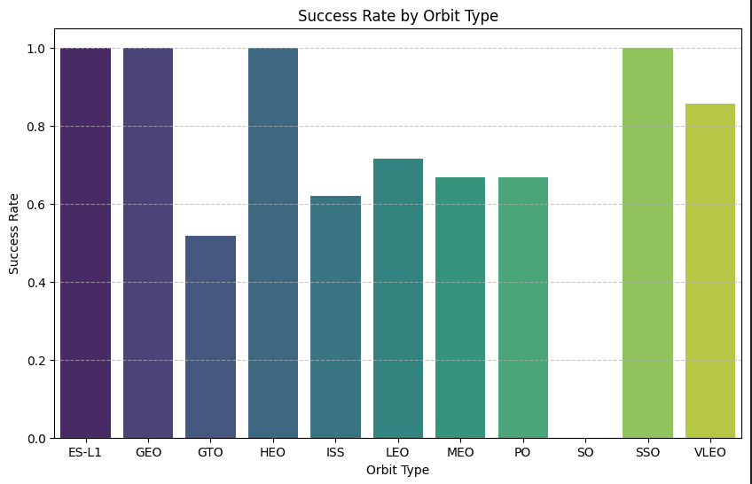
REsults
EDA with visualization
This bar chart visualizes the success rate of SpaceX launches for different orbit types. Key observations include:
Highest Success Rates (100%): Orbits such as ES-L1, GEO, HEO, and SSO have a perfect success rate, indicating consistent reliability for these missions.
Moderate Success Rates (60-80%): Orbits like LEO, MEO, and PO show moderate success rates, with successful outcomes being more frequent than failures.
Lowest Success Rate (below 50%): The GTO orbit stands out with the lowest success rate, highlighting challenges or complexities in achieving consistent success for missions targeting this orbit.
ISS and VLEO Orbits: These orbits exhibit a slightly better-than-average success rate but do not reach the reliability of orbits like GEO or SSO.
This chart highlights that the choice of orbit type can significantly influence mission outcomes, with some orbits proving more challenging than others.

Slide 19
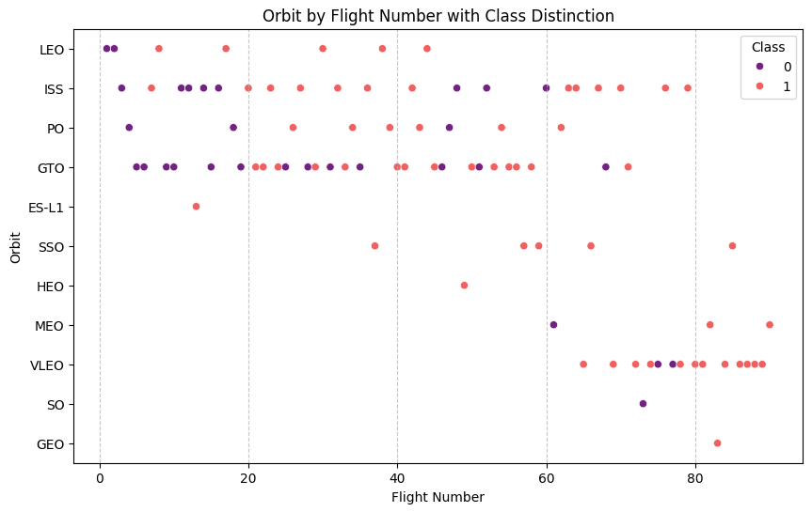
REsults
EDA with visualization
This scatterplot shows the relationship between flight number and orbit type, highlighting success (red, Class 1) or failure (purple, Class 0):
Successful launches (Class 1): Increase with later flights, indicating improved performance over time.
Failed launches (Class 0): More common in early missions, reflecting initial challenges.
Orbit trends:
LEO and ISS: Mixed results with increasing success in later flights.
GTO: Balanced mix of successes and failures, showing challenges in this orbit.
Rare orbits (GEO, ES-L1, SSO): Mostly successful, reflecting specialized missions.
This visualization suggests SpaceX's learning curve and technical advancements as flight numbers increase, leading to improved reliability and success rates across most orbits.

Slide 20
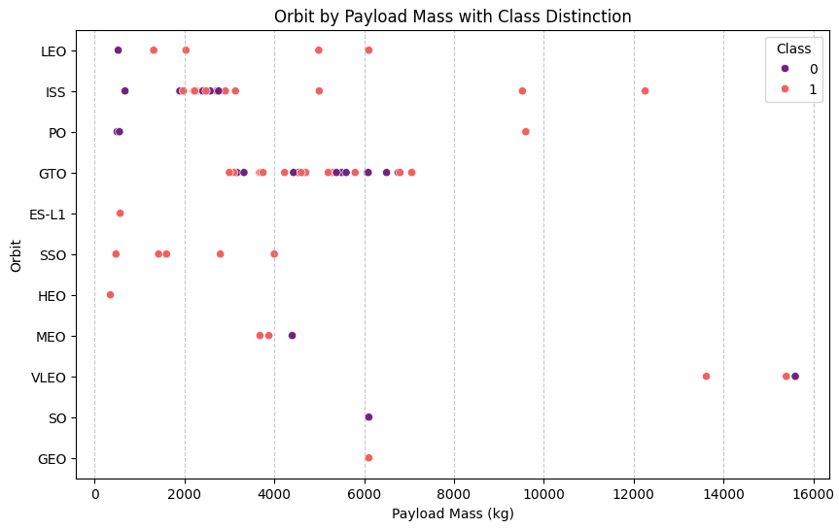
REsults
EDA with visualization
This scatterplot shows the relationship between payload mass (x-axis) and orbit type (y-axis), with class distinction indicating the success (1) or failure (0) of the launches:
LEO and ISS: Wide payload range with increasing success for higher payloads.
GTO: Mixed outcomes, reflecting challenges across payloads.
High-payload missions (>10,000 kg): Mostly successful, especially in GEO and some LEO missions.
Specialized orbits (SSO, ES-L1, VLEO): Predominantly successful, likely due to specific mission designs.
The chart highlights how payload mass influences mission outcomes across different orbits, showcasing SpaceX's growing expertise.

Slide 21
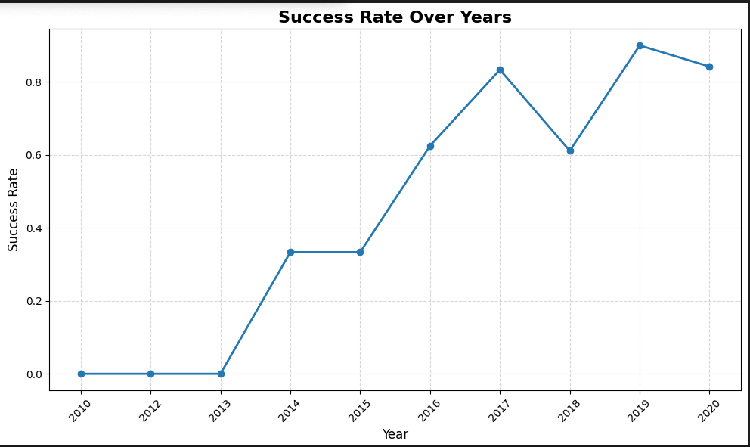
REsults
EDA with visualization
This graph shows SpaceX's success rate from 2010 to 2020, highlighting key milestones:
2010-2012: No successful landings, with a 0% success rate.
2013-2014: Gradual progress, reaching a 40% success rate by 2014.
2015-2016: Steady growth, achieving 60% success by 2016.
2017-2018: Temporary dip in 2017, followed by recovery and over 80% success in 2018.
2019-2020: Consistently high success rates above 80%, reflecting operational maturity.
The graph illustrates SpaceX's technological advancement and operational learning curve, showcasing how the company has achieved consistent and reliable rocket landings over a decade. This upward trend reflects their success in reusability and cost-efficiency in space exploration.

Slide 22
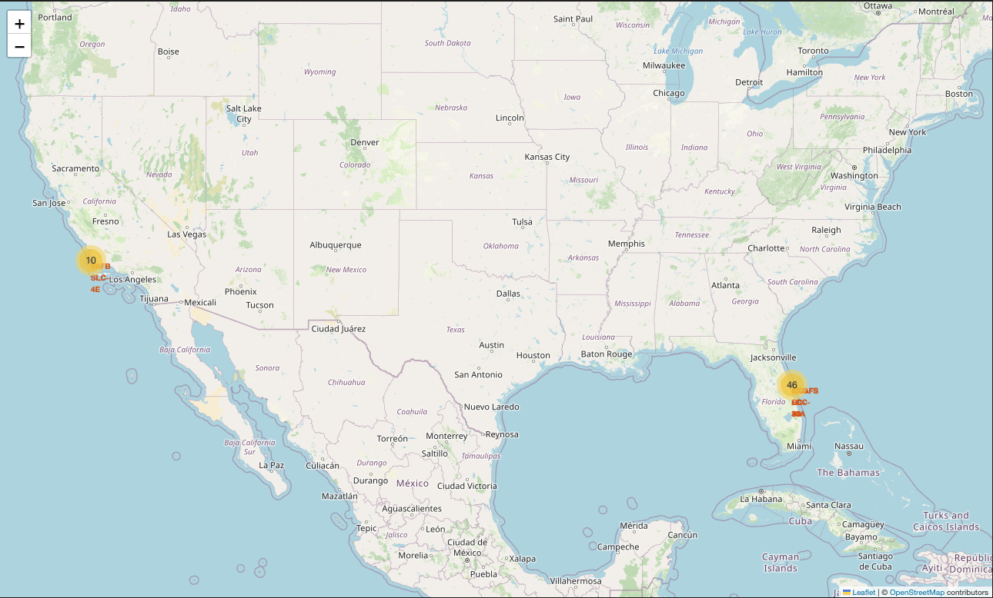
REsults
Interactive map with Folium
Launch Site Locations
All SpaceX launch sites are represented on the map with blue circles and labeled markers, offering a clear overview of their geographic distribution.
Sites are strategically positioned near coastlines to enhance safety during launches.
The map reflects the functional differentiation of sites, such as VAFB for polar orbits and Florida sites for equatorial orbits, showcasting SpaseX’s strategic considerations for optimal operations.

Slide 23
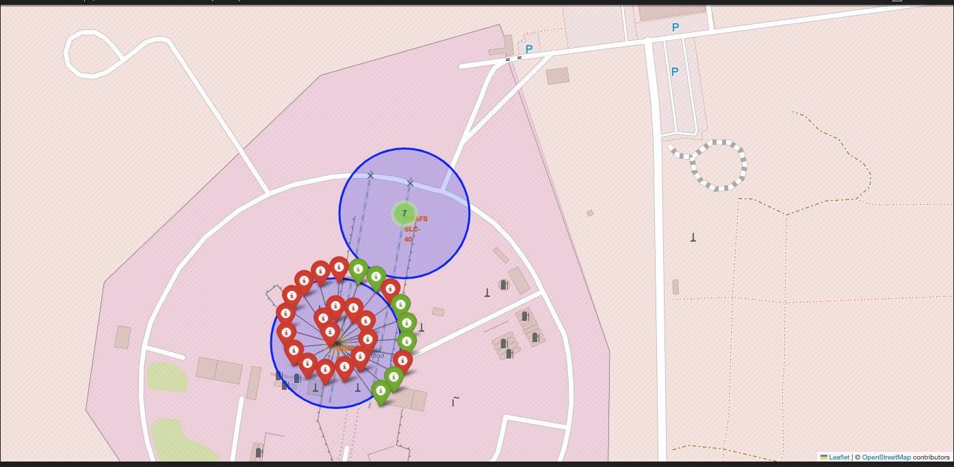
REsults
Interactive map with Folium
Success and Failure Visualization
Marker clusters depict individual launches with green markers for successes and red for failures, enabling a quick assessment of site-specific performance trends.

Slide 24
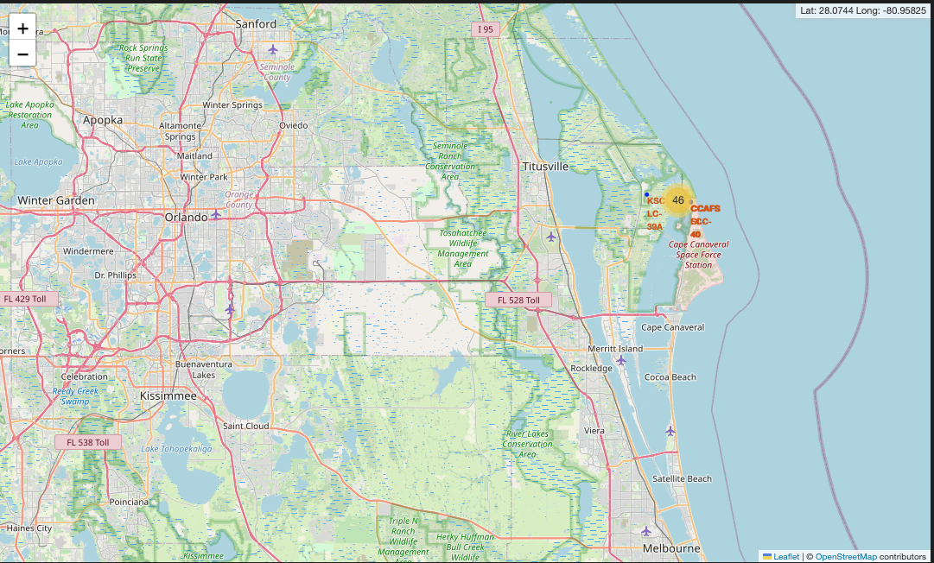

REsults
Interactive map with Folium
Interactive Features
Interactive elements, such as mouseover coordinates and pop-ups with detailed site information, enhance user engagement and exploration.

Slide 25
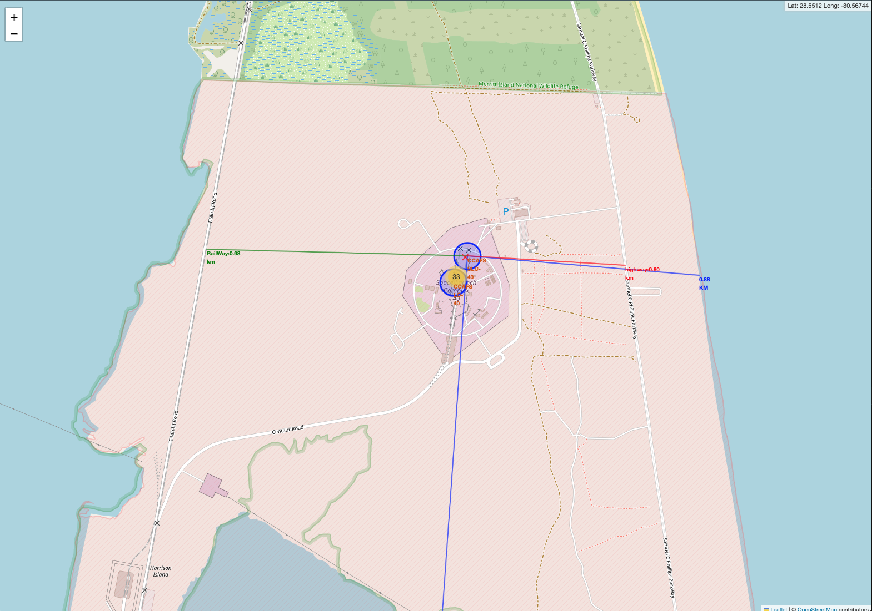
REsults
Interactive map with Folium
Interactive Features
Blue, green, and red lines show calculated distances to nearby features, emphasizing the strategic design and operational planning of each site.
Distances from launch sites to coastlines, highways, railways, and cities are illustrated, demonstrating the sites' accessibility and logistical support.

Slide 26
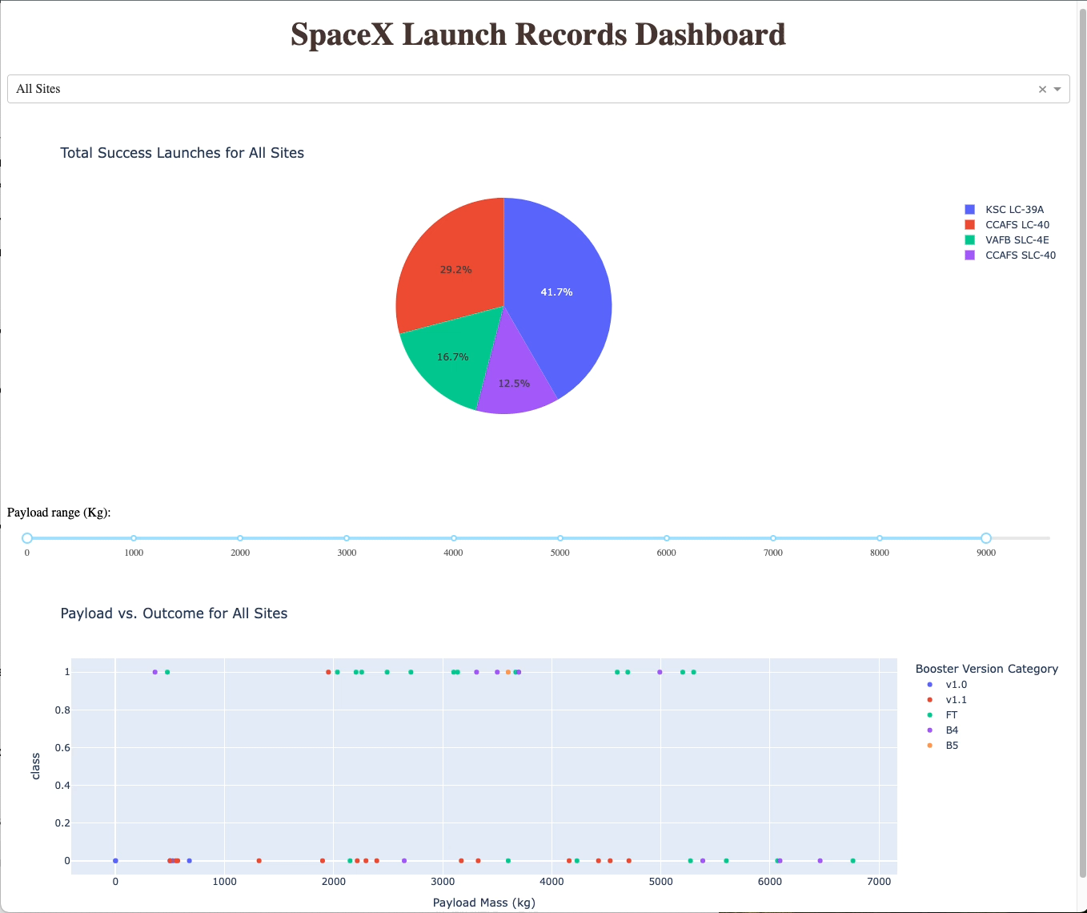
REsults
Plotly Dash dashboard
Launch Success Analysis:
A pie chart shows total successes by site or for all sites combined.
Payload vs Success:
A scatter plot highlights the relationship between payload mass and launch outcomes, with filtering by site and payload range.
Interactive Filters:
Dropdown menu for site selection and a slider for payload range adjustment.
The dashboard provides a user-friendly interface for exploring SpaceX's operational trends and booster performance, offering clear insights into payload success rates and site efficiencies.

Slide 27
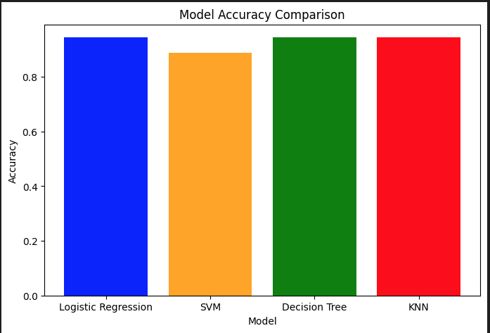
REsults
Predictive Analysis (classification)
Bar Chart for Model Accuracy Comparison
A visual comparison of test accuracies for all models.
Emphasizes the strong performance of Logistic Regression and KNN, with consistent results across all metrics.

Slide 28
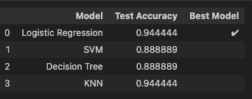
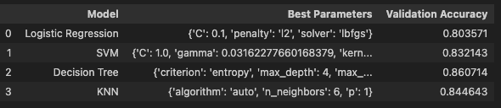
REsults
Predictive Analysis (classification)
Test Accuracies and Best Model
The table showcases test accuracy for four models: Logistic Regression, SVM, Decision Tree, and KNN.
Logistic Regression and KNN achieved the highest test accuracy (94.4%).
Logistic Regression is highlighted as the best model based on accuracy and consistency.
Hyperparameter Tuning Results
Displays the best hyperparameters and validation accuracies achieved using GridSearchCV for each model.Decision Tree had the highest validation accuracy, but Logistic Regression proved more reliable on test data.

Slide 29
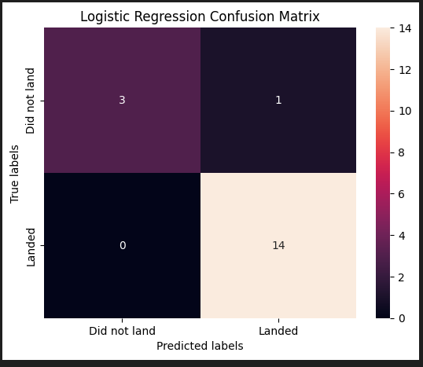
REsults
Predictive Analysis (classification)
Confusion Matrix for Logistic Regression
Visual representation of true positives, false positives, true negatives, and false negatives for the Logistic Regression model.
Hyperparameter Tuning Results
Highlights its reliability, with minimal false positives and high classification accuracy.

Slide 30


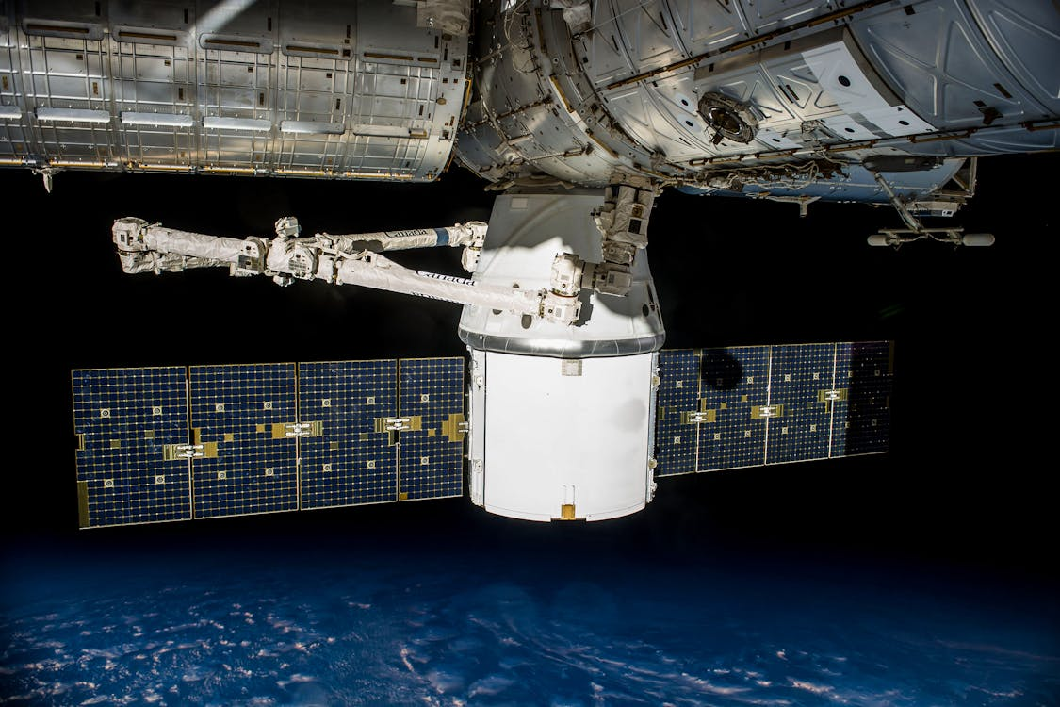
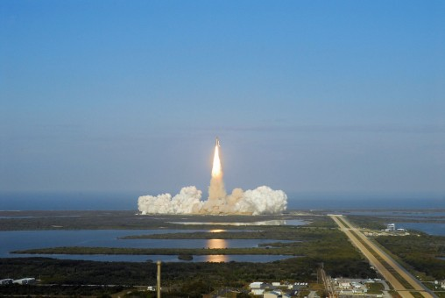
Conclusion
This project gave us some fascinating insights into SpaceX launches and how data can help predict success:
What We Learned:
Payload mass, orbit type, and launch sites play a big role in launch outcomes.
SpaceX has clearly gotten better over time, with higher success rates showing how much they’ve improved.
How We Showed It:
Interactive maps and dashboards helped us see where and why launches succeeded or failed.
Visualizations made it easy to spot trends and patterns across different missions.
Modeling Success:
Logistic Regression and KNN came out on top, with both achieving a test accuracy of 94.4%.
Hyperparameter tuning showed how small tweaks can make a big difference in model performance.
Takeaways:
SpaceX’s focus on learning from each launch is paying off in reliability and cost savings.
Predictive models like these are great tools for planning future launches and staying ahead of the competition.
In short, this project was a great example of how data science and machine learning can help solve real-world challenges—even ones as big as space exploration!

Slide 31

Appendix
Resources Used in the Project
SpaceX Official Website: https://www.spacex.com For understanding SpaceX’s mission, launches, and reusability efforts.
Dataset Sources:
Launch Data: SpaceX Launch Data on Kaggle (or the exact link if provided in your project source).
Supplementary Data: IBM Skills Network Datasets
Dash and Plotly for Visualization: https://dash.plotly.com Guide to interactive dashboards used in the project.
Scikit-learn Documentation: https://scikit-learn.org For information on GridSearchCV, hyperparameter tuning, and classification algorithms.
Author Profile:
LinkedIn Profile
GitHub Repository
Python Libraries Documentation:
Pandas: https://pandas.pydata.org
NumPy: https://numpy.org
Seaborn: https://seaborn.pydata.org

